Slide 1
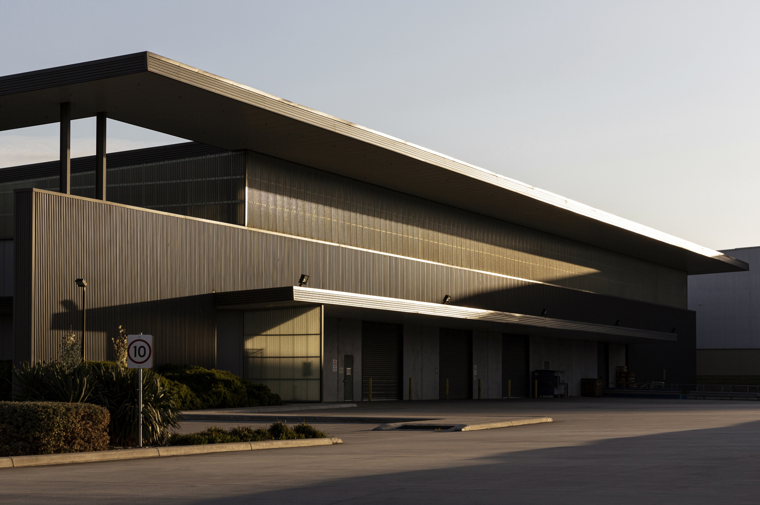

BROKER OPINION OF VALUE
SEPTEMBER 2023

Slide 2
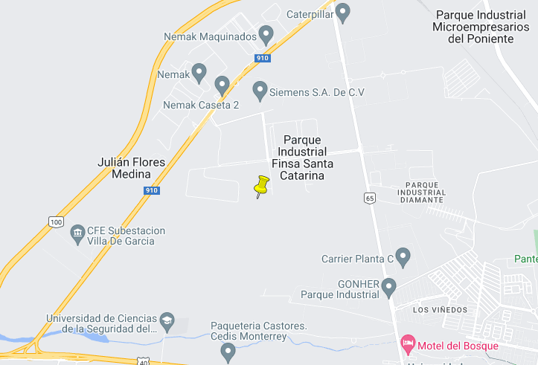
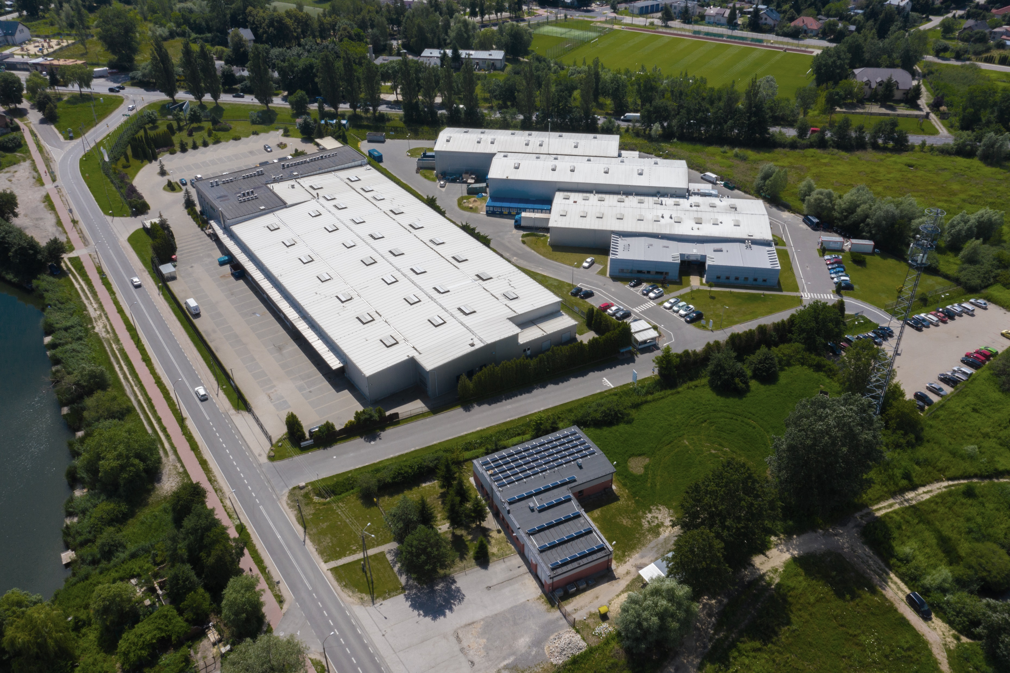
The offering
The offering
CBRE, Inc. has been retained as exclusive
Advisor and agent to present to qualified
investors the chance to acquire an industrial
asset located in Parque industrial Finsa, located
in a high growth industrial zone in Monterrey.
Asset

Slide 3
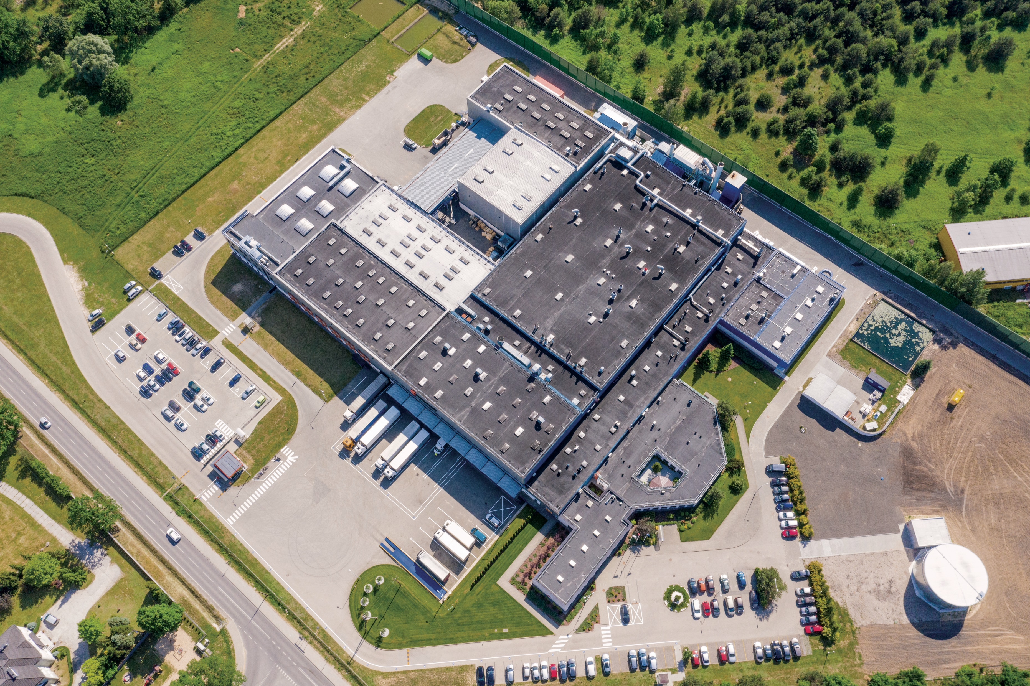
The offering
Property description
This industrial park is a Sunnybrook is a 18,800 square foot facility
in Santa Catarina, a fast-growing area located in the metropolitan
area of Monterrey. The area is poised for significant growth in the
Short-mid term due to the actual fast growth of the state and near
shoring.
Some of the characteristics of the property:
Parking lots
Loading and unloading zone for trucks
Easy connection with important highways
Access to all utilities services
Accesible location
Area | Gross leasable area
375,164 Sq.F. | 181,800 Sq.F.

Slide 4
The offering
Financial Info

Slide 5
The offering
Financial Info

Slide 6
